Slide 1
K-means
CS 506

Slide 2
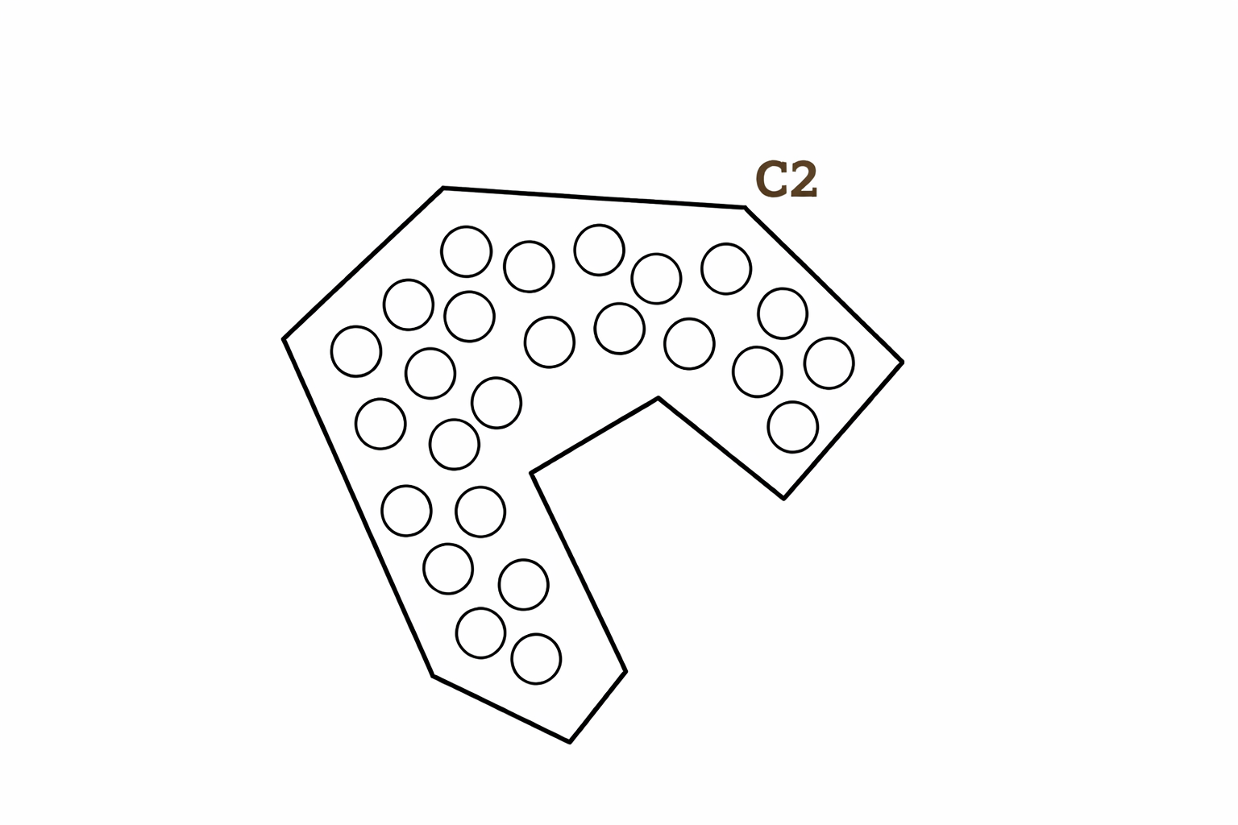
What is the center of C2?

Slide 3
What is the center of C2?

Slide 4
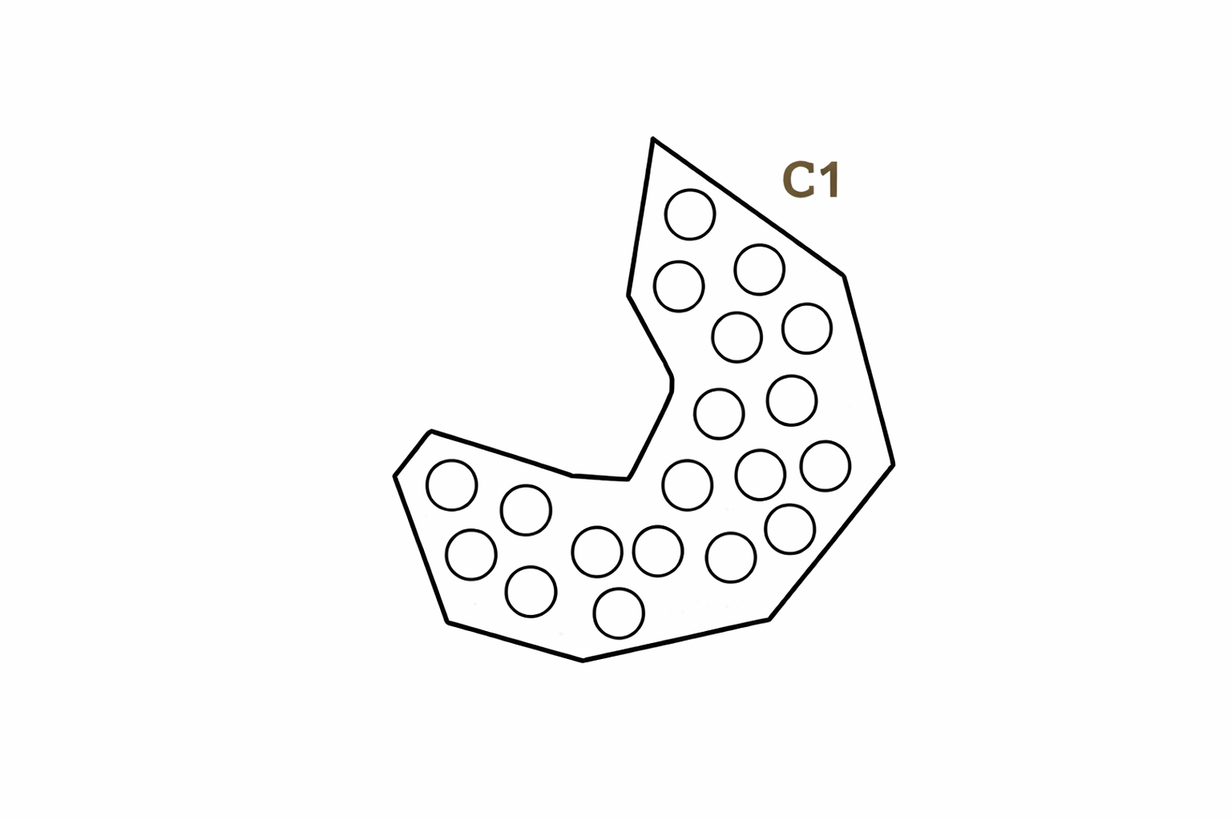
What is the center of C1?

Slide 5
What is the center of C1?

Slide 6
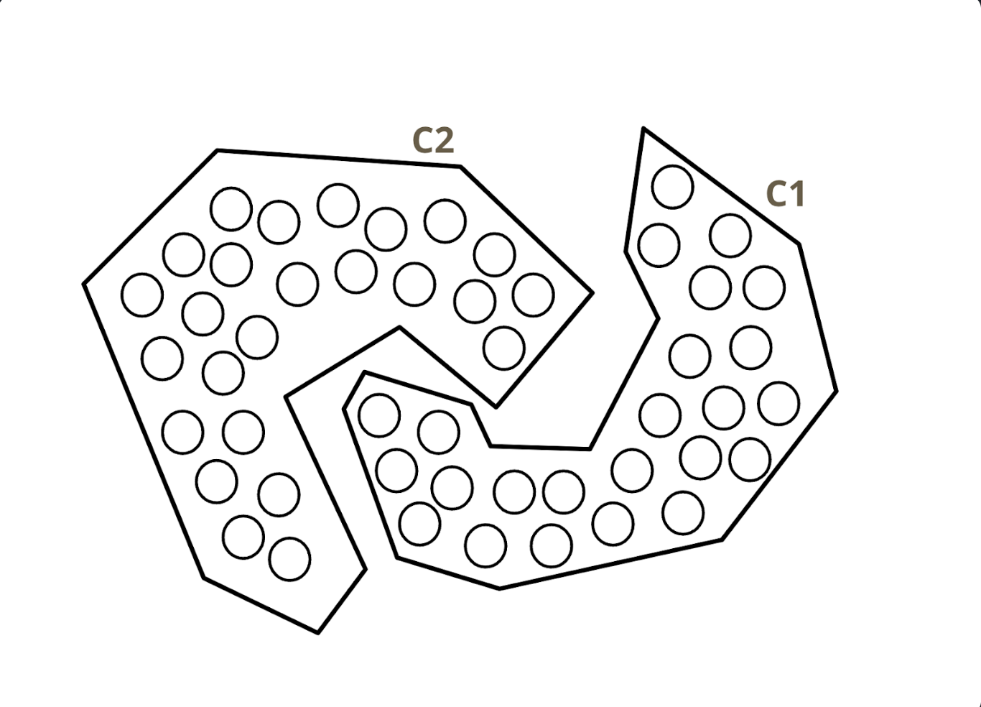
Hmmm… does this make sense?
i.e., if we were to iterate through Lloyd’s algorithm again, would we have this clustering?

Slide 7
Another perspective: can we minimize our cost function any further?
We want to compute the center of each cluster and see if any of the points in one cluster is closer to the center of the other cluster.

Slide 8
Another perspective: can we minimize our cost function any further?
We want to compute the center of each cluster and see if any of the points in one cluster is closer to the center of the other cluster.
In this case, there are points in C1 closer to C2’s mean and vice-versa. Hence, K-means cannot converge to this clustering!

Slide 9
Key Takeaway: Why This Clustering Fails
Lloyd’s algorithm only guarantees convergence to a local optimum not necessarily the best possible clustering.
  Whether it lands on a good or a bad clustering depends heavily on where the centroids started.
If reassigning even one point to a different cluster would lower the total cost, the algorithm hasn’t truly settled on the best solution, exactly what we just saw with the spiral example.
  In practice: run K-means many times with different random initializations (scikit-learn’s n_init parameter) and keep the lowest-cost result.
Next: let’s precisely define the cost function that K-means is trying to minimize.

Slide 10
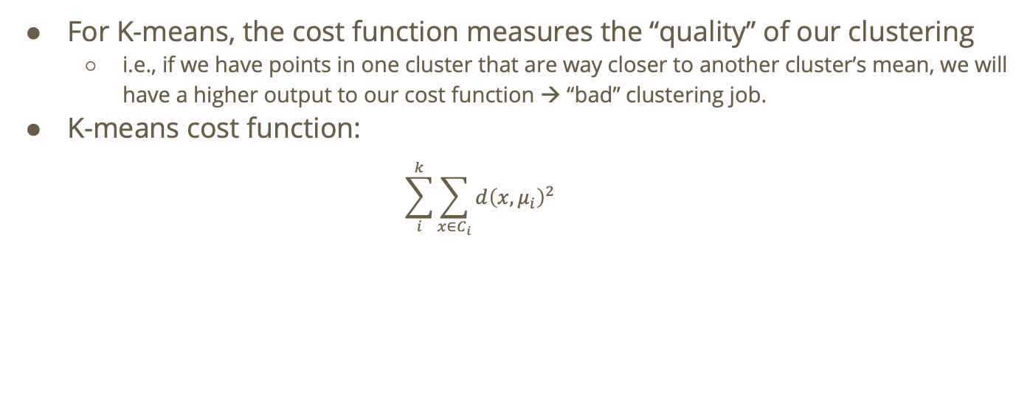
What exactly is the cost function?
For K-means, the cost function measures the “quality” of our clustering
  i.e., if we have points in one cluster that are way closer to another cluster’s mean, we will have a higher output to our cost function → “bad” clustering job.
K-means cost function:
  $$\sum_{i}^{k}{\sum_{x∈C_{i}}{d{\left(x,μ_{i}\right)}^{2}}}$$

Slide 11
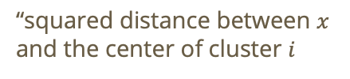
What exactly is the cost function?
For K-means, the cost function measures the “quality” of our clustering
  i.e., if we have points in one cluster that are way closer to another cluster’s mean, we will have a higher output to our cost function → “bad” clustering job.
K-means cost function:
  $$\sum_{i}^{k}{\sum_{x∈C_{i}}{d{\left(x,μ_{i}\right)}^{2}}}$$
“squared distance between $x$ and the center of cluster $i$

Slide 12
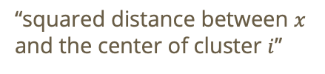

What exactly is the cost function?
For K-means, the cost function measures the “quality” of our clustering
  i.e., if we have points in one cluster that are way closer to another cluster’s mean, we will have a higher output to our cost function → “bad” clustering job.
K-means cost function:
  $$\sum_{i}^{k}{\sum_{x∈C_{i}}{d{\left(x,μ_{i}\right)}^{2}}}$$
“squared distance between $x$ and the center of cluster $i$”
“sum for all points in cluster $i$”

Slide 13


What exactly is the cost function?
For K-means, the cost function measures the “quality” of our clustering
  i.e., if we have points in one cluster that are way closer to another cluster’s mean, we will have a higher output to our cost function → “bad” clustering job.
K-means cost function:
  $$\sum_{i}^{k}{\sum_{x∈C_{i}}{d{\left(x,μ_{i}\right)}^{2}}}$$
“sum over all k clusters”
“squared distance between $x$ and the center of cluster $i$”
“sum for all points in cluster $i$”

Slide 14
Do not edit
How to change the design
For a dataset X with N points, when k = 1, the total cost is:
The Slido app must be installed on every computer you’re presenting from

Slide 15
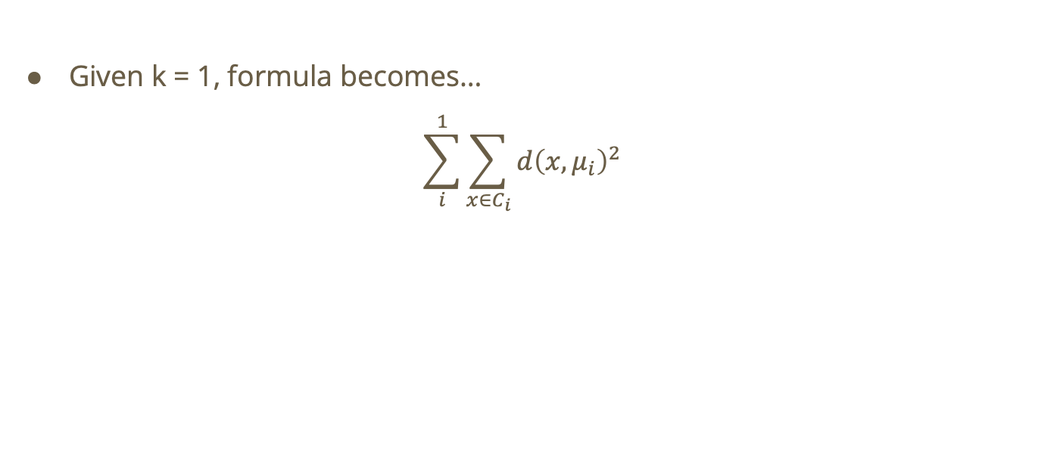
Solution
Given k = 1, formula becomes…
$$\sum_{i}^{1}{\sum_{x∈C_{i}}{d{\left(x,μ_{i}\right)}^{2}}}$$

Slide 16
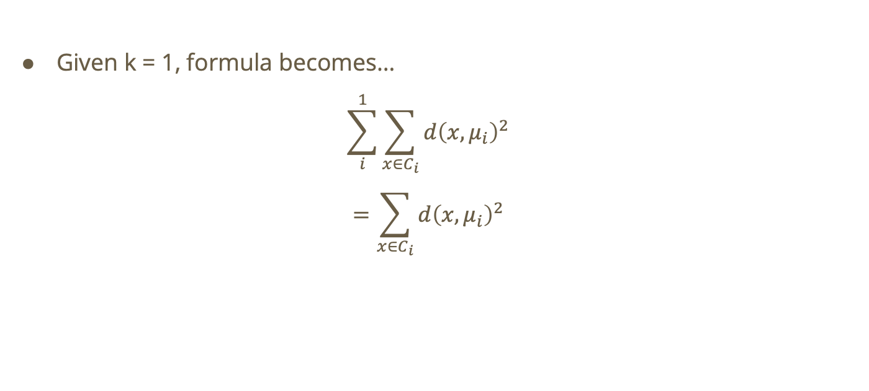
Solution
Given k = 1, formula becomes…
$$\sum_{i}^{1}{\sum_{x∈C_{i}}{d{\left(x,μ_{i}\right)}^{2}}}$$
$$=\sum_{x∈C_{i}}{d{\left(x,μ_{i}\right)}^{2}}$$

Slide 17
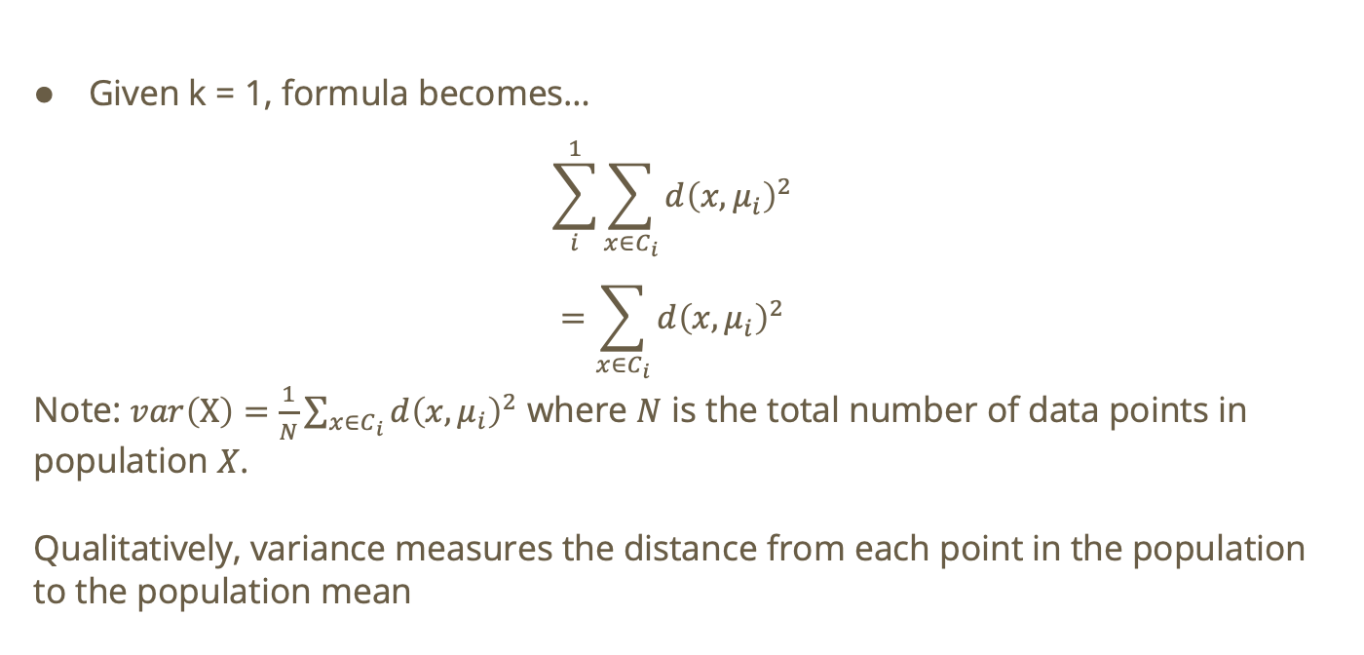
Solution
Given k = 1, formula becomes…
$$\sum_{i}^{1}{\sum_{x∈C_{i}}{d{\left(x,μ_{i}\right)}^{2}}}$$
$$=\sum_{x∈C_{i}}{d{\left(x,μ_{i}\right)}^{2}}$$
Note: $var\left(X\right)=\frac{1}{N}\sum_{x∈C_{i}}{d{\left(x,μ_{i}\right)}^{2}}$ where $N$ is the total number of data points in population $X$.
Qualitatively, variance measures the distance from each point in the population to the population mean

Slide 18
Do not edit
How to change the design
For a dataset X with N points, when k = N the total cost is:
The Slido app must be installed on every computer you’re presenting from

Slide 19

Solution
When $k = N:$
  Each cluster will only have 1 point
  Distance between each point in a cluster and the center is 0 (the center of the cluster will lie on the single point!)

Slide 20
Lloyd’s Algorithm, Step by Step
Initialize — randomly choose k points as the starting centroids μ₁, …, μₖ.
  The starting positions matter: different initial centroids can lead the algorithm to completely different final clusters.
Assign — for every data point, measure its distance to all k centroids and assign it to the nearest one.
  This groups the data into k clusters based on where the centroids currently sit.
Update — recompute each centroid as the mean position of all points now assigned to it.
  Each centroid moves toward the “center of mass” of its cluster.
Repeat — alternate the Assign and Update steps until the assignments stop changing.
  Each full pass never increases the total cost — it only goes down or stays the same.
  Converged! Once Assign produces the same clusters as the previous round, the centroids have stabilized.

Slide 21
Do not edit
How to change the design
True or False: Lloyd’s algorithm always converges
The Slido app must be installed on every computer you’re presenting from

Slide 22
Solution
True.
  Lloyd’s algorithm always converges in a finite number of iterations.
  Why: there are only finitely many ways to partition N points into k clusters, and the total cost is non-increasing at every step, so it can’t loop forever.
  Careful: “converges” just means the assignments stop changing (a local optimum), it does NOT mean K-means found the best possible clustering. See “Key Takeaway” earlier in the deck!

Slide 23
Lloyd’s Algorithm: What Convergence Really Means
Always converges: with N points and k clusters there are only finitely many ways to partition the data, and the cost never increases, so the algorithm must stop after a finite number of iterations.
But not to the global optimum: it stops at a local optimum, a point where no single reassignment helps, which may not be the best clustering overall (recall the spiral example!).
Sensitive to initialization: a poor set of starting centroids can trap the algorithm in a bad clustering.
  In practice: scikit-learn’s KMeans reruns the algorithm from several random initializations (n_init) and keeps the lowest-cost result; smarter seeding (k-means++) also helps.
Cost per iteration: O(N·k·d) for N points, k clusters, d dimensions — fast, which is part of why K-means scales to large datasets.

Slide 24
Do not edit
How to change the design
Dataset: [−2,−1.5, .5, 1, 5.5, 6, 6.5]. With initial centroids 0 and 2, what
are the final centroids?
The Slido app must be installed on every computer you’re presenting from

Slide 25

Solution
We’re given that $C_{1}=0 C_{2}=2$
  This is equivalent to $μ_{1}=0 μ_{2}=2$

Slide 26

Solution
We’re given that $C_{1}=0 C_{2}=2$
  This is equivalent to $μ_{1}=0 μ_{2}=2$
Based on the K-means algorithm, each point will be assigned to the closest cluster mean. Hence, we get the following clusters:
  $$C_{1}=\{−2,−1.5,0.5,1\} C_{2}=\{5.5,6,7.5\}$$

Slide 27
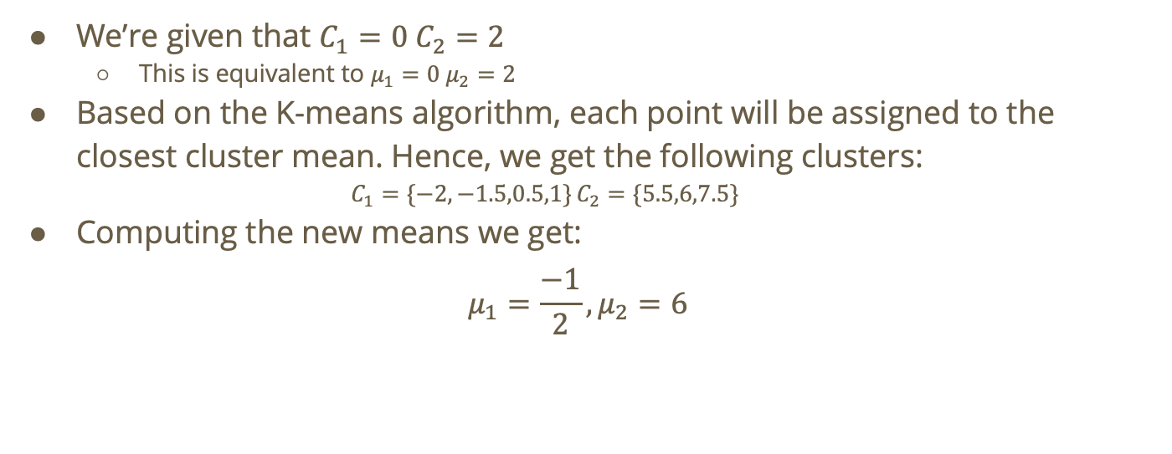
Solution
We’re given that $C_{1}=0 C_{2}=2$
  This is equivalent to $μ_{1}=0 μ_{2}=2$
Based on the K-means algorithm, each point will be assigned to the closest cluster mean. Hence, we get the following clusters:
  $$C_{1}=\{−2,−1.5,0.5,1\} C_{2}=\{5.5,6,7.5\}$$
Computing the new means we get:
$$μ_{1}=\frac{−1}{2},μ_{2}=6$$

Slide 28
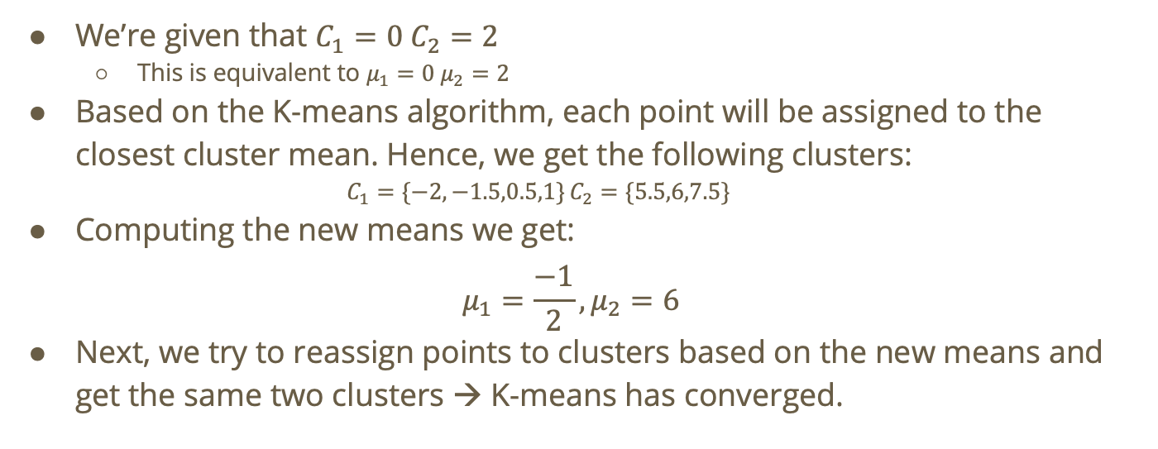
Solution
We’re given that $C_{1}=0 C_{2}=2$
  This is equivalent to $μ_{1}=0 μ_{2}=2$
Based on the K-means algorithm, each point will be assigned to the closest cluster mean. Hence, we get the following clusters:
  $$C_{1}=\{−2,−1.5,0.5,1\} C_{2}=\{5.5,6,7.5\}$$
Computing the new means we get:
$$μ_{1}=\frac{−1}{2},μ_{2}=6$$
Next, we try to reassign points to clusters based on the new means and get the same two clusters → K-means has converged.

Slide 29
Do not edit
How to change the design
Consider the 1-dimensional dataset: [3, 5, x]. With k = 2, what is the
smallest integer value of x, (x > 5) for which x will always be alone in its
own cluster no matter the initialization?
The Slido app must be installed on every computer you’re presenting from

Slide 30

Solution
Consider the following clustering: $C_{1}=\{3\} C_{2}=\{ 5,x\}$

Slide 31

Solution
Consider the following clustering: $C_{1}=\{3\} C_{2}=\{ 5,x\}$
$$μ_{1}=3,μ_{2}=\frac{5+x}{2}$$
Question: for what $x$ will 5 switch clusters? i.e., $d\left(5,μ_{1}\right)<d\left(5,μ_{2}\right)$

Slide 32
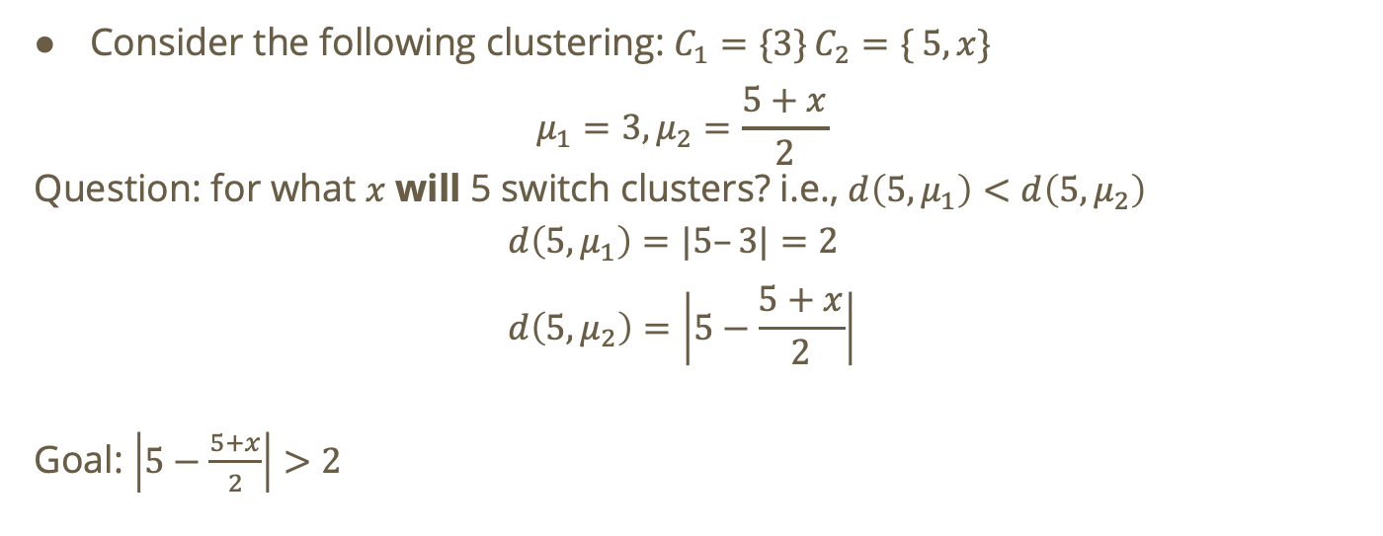
Solution
Consider the following clustering: $C_{1}=\{3\} C_{2}=\{ 5,x\}$
$$μ_{1}=3,μ_{2}=\frac{5+x}{2}$$
Question: for what $x$ will 5 switch clusters? i.e., $d\left(5,μ_{1}\right)<d\left(5,μ_{2}\right)$
$$d\left(5,μ_{1}\right)=|5–3|=2 \\ d\left(5,μ_{2}\right)=\left|5−\frac{5+x}{2}\right|$$
Goal: $\left|5−\frac{5+x}{2}\right|>2$

Slide 33

Solution
Goal: $\left|5−\frac{5+x}{2}\right|>2$
$$\left|5−\frac{5+x}{2}\right|>2$$
$$=\left|\frac{10−\left(5+x\right)}{2}\right|>2$$
$$=\left|\frac{5−x}{2}\right|>2$$
$$=\frac{\left|5−x\right|}{2}>2$$

Slide 34

Solution
Goal: $\left|5−\frac{5+x}{2}\right|>2$
$$\frac{\left|5−x\right|}{2}>2$$
Recall: $x>5$
$$=\frac{x−5}{2}>2$$
$$= x >9$$
Interpretation: if $x >9$then we will end with the clustering $C_{1}=\{3, 5\} C_{2}=\{ x\}$

